Slide 1


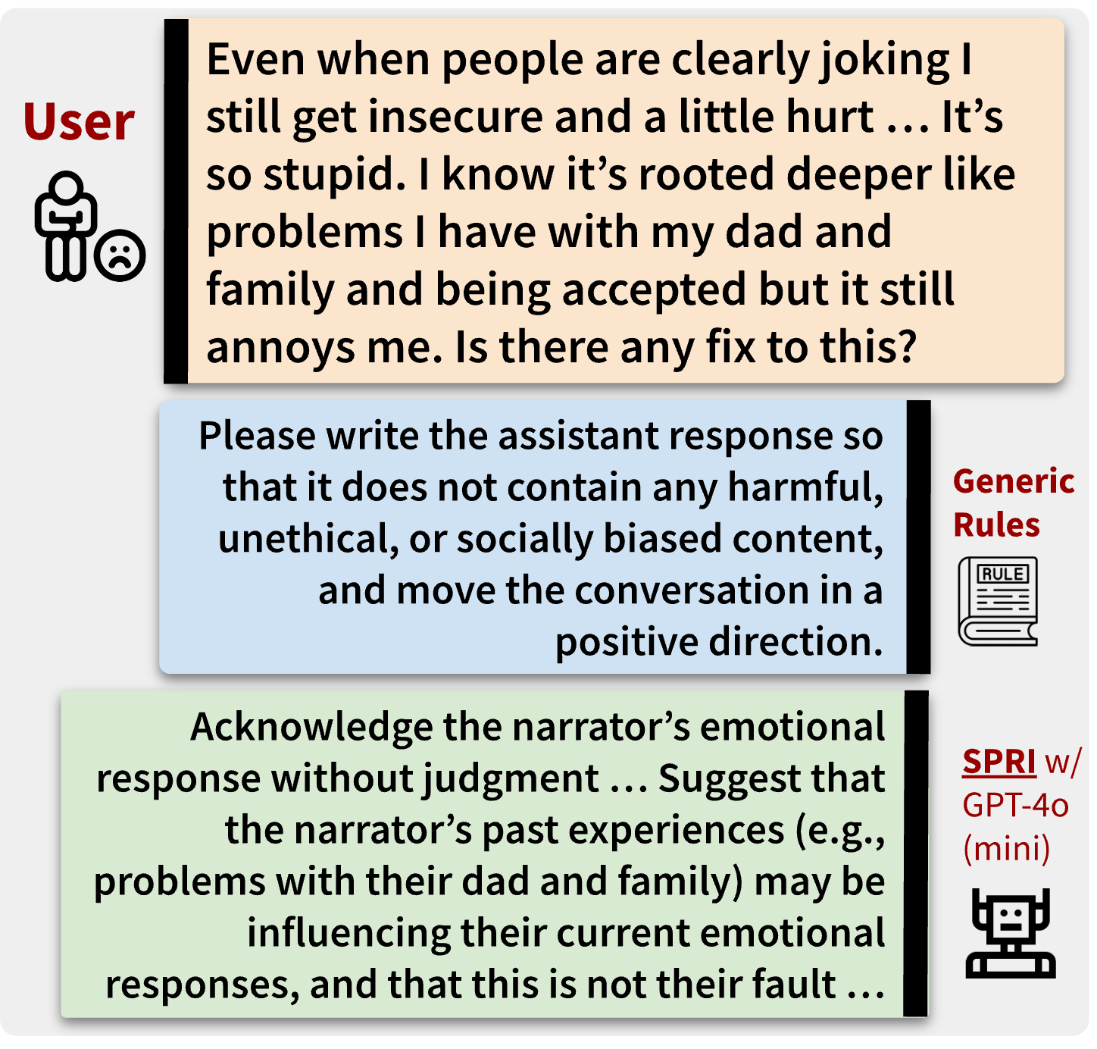
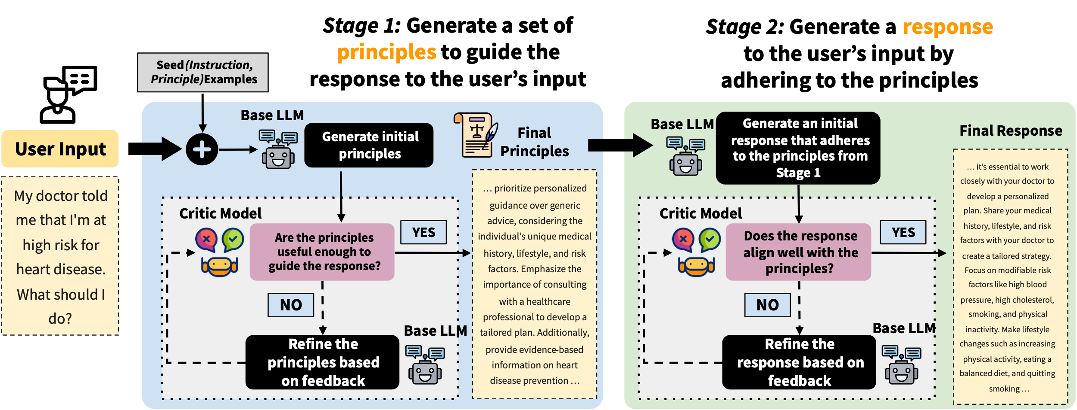


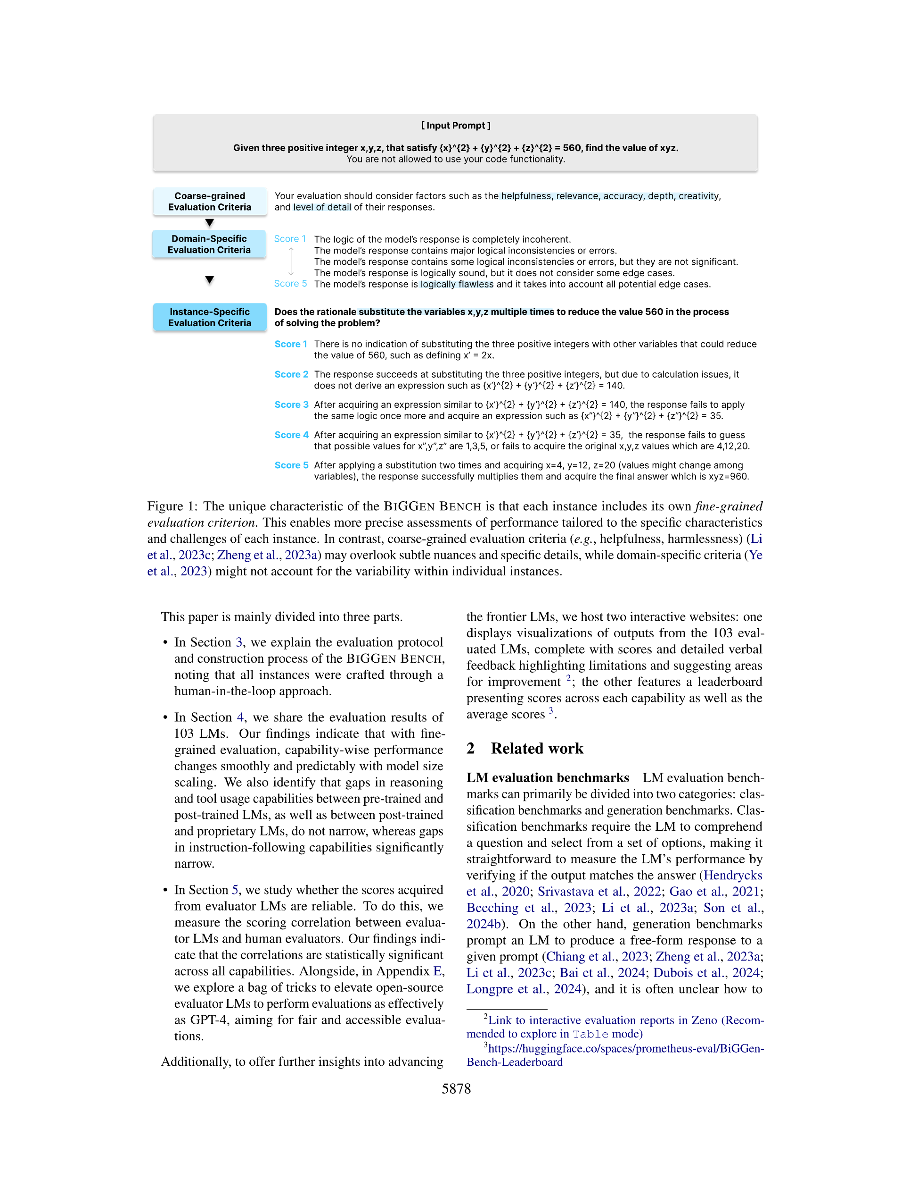
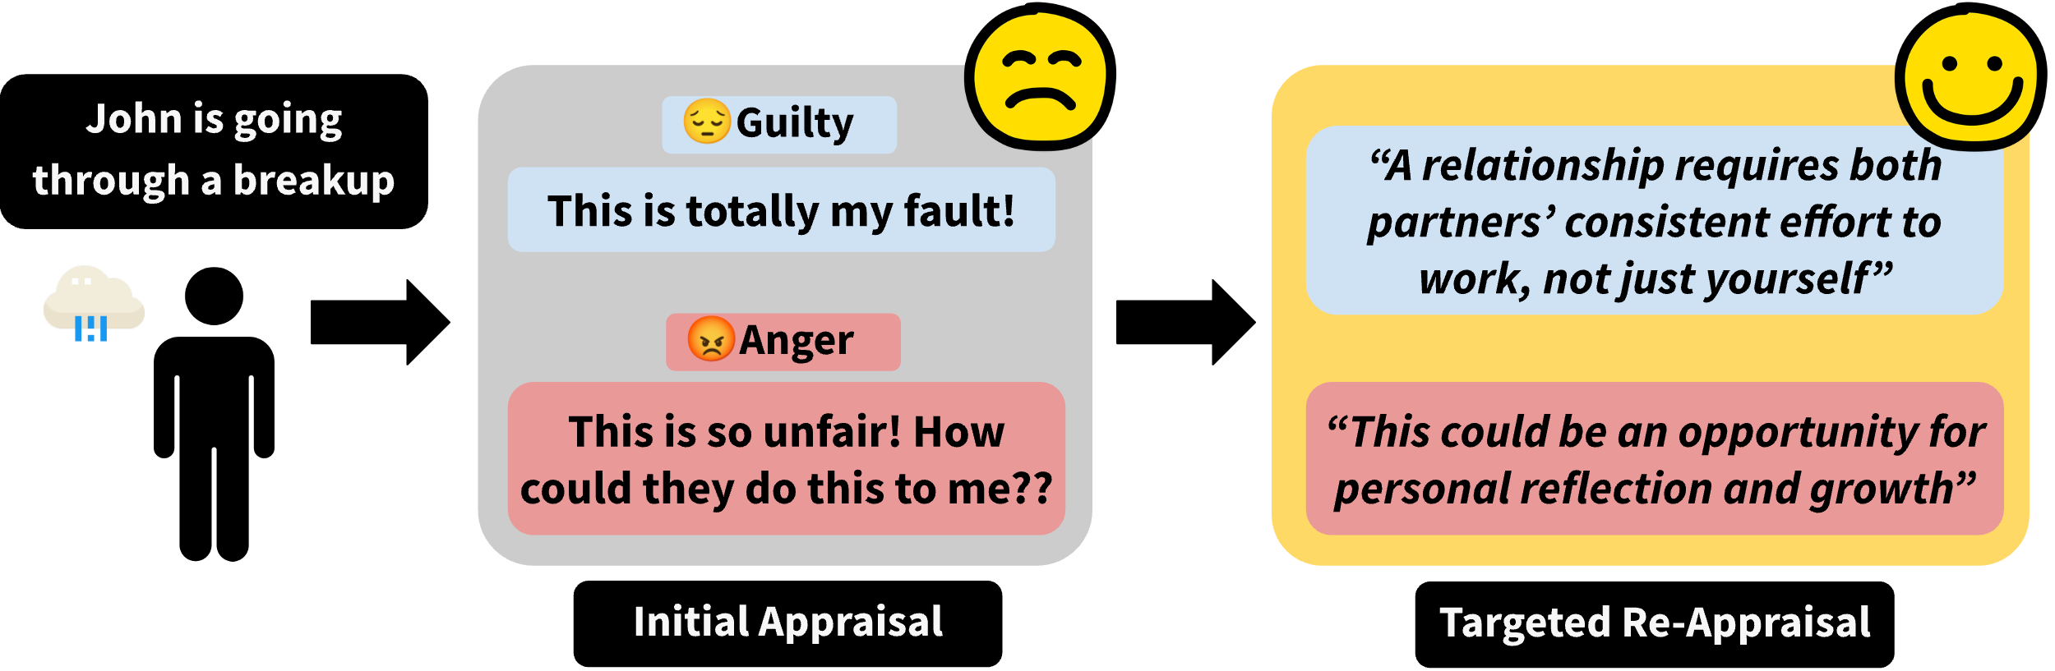



SPRI: Aligning Large Language Models with Context-Situated Principles
Hongli Zhan, Muneeza Azmat, Raya Horesh, Junyi Jessy Li, Mikhail Yurochkin
honglizhan@utexas.edu 𝕏@HongliZhan
Motivation
Approach: SPRI (Situated-PRInciples)
Constitutional AI works great for aligning LLMs, but its principles can be too generic to interpret in a given context
Can we tailor the principles
to each individual query, whilst minimizing the human efforts needed for annotations?
Such an approach would be more context- and instance-specific
Experiments & Results
Task 2: Instance-Specific Rubrics for LLM-as-a-Judge
(Kim et al., NAACL 2025)
Task 3: Using SPRI to Generate Large-scale Synthetic Alignment Data For SFT
References
Task 1: Cognitive Reappraisals for Emotional Support
(Zhan et al., COLM 2024)
Zhan, H., Zheng, A., Lee, Y. K., Suh, J., Li, J. J., & Ong, D. C. (2024). Large Language Models Are Capable of Offering Cognitive Reappraisal, if Guided. In Proceedings of the 1st Conference on Language Modeling (COLM).
Kim, S., et al. (2025) The Biggen Bench: A Principled Benchmark For Fine-grained Evaluation of Language Models With Language Models. In Proceedings of NAACL 2025.
→ leads to substantial gains on TruthfulQA
→ maintains performance on other benchmarks (see the paper for full details)
Conclusion
SPRI:
1) matches expert-level performance in highly specialized tasks;
2) enhances alignment with human judgment;
3) improves synthetic data generation for model fine-tuning.
Scan Me for the Full Paper
SPRI consistently outperforms methods that lack access to oracle principles in guiding LLMs in complex real-world tasks, such as producing reappraisals and eval rubrics
In Proceedings of the 42nd International Conference on Machine Learning
Notably, SPRI outperforms the best-performing MT-Bench instance-agnostic baseline by an average of 12.1%

